Slide 1
SECURE THE FUTURE: FINANCE
By BRIAN SOWERS
JAN 2024

Slide 2
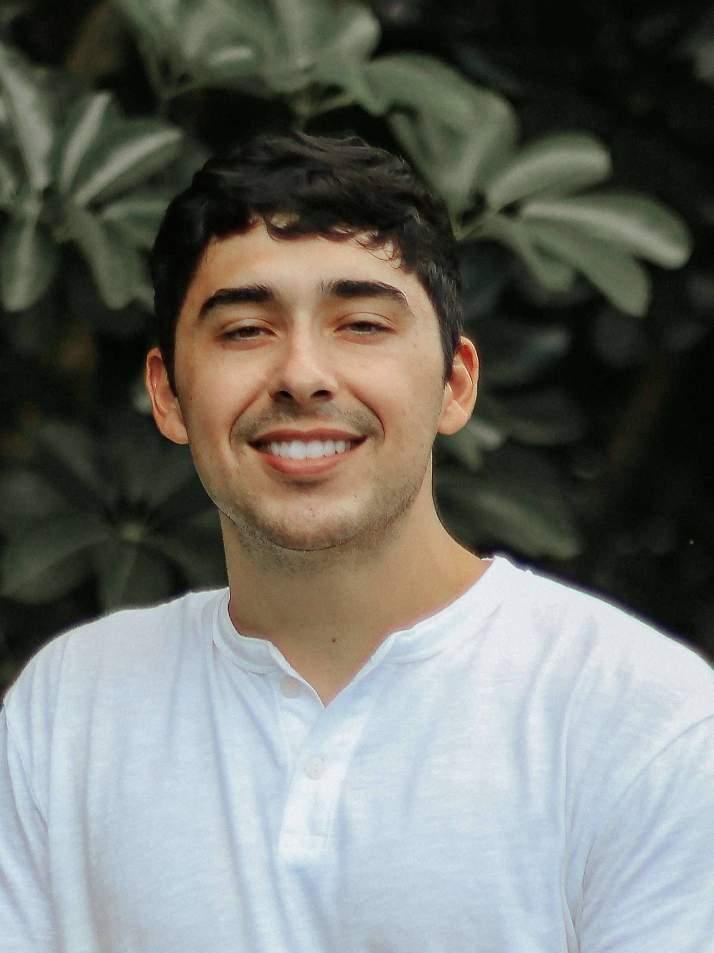
About Me:
Name: Brian Sowers
College: Columbia University
Major: Information Science, B.A.
Hometown: Houston, TX
Fun Fact: I learned how to ski this winter break!

Slide 3
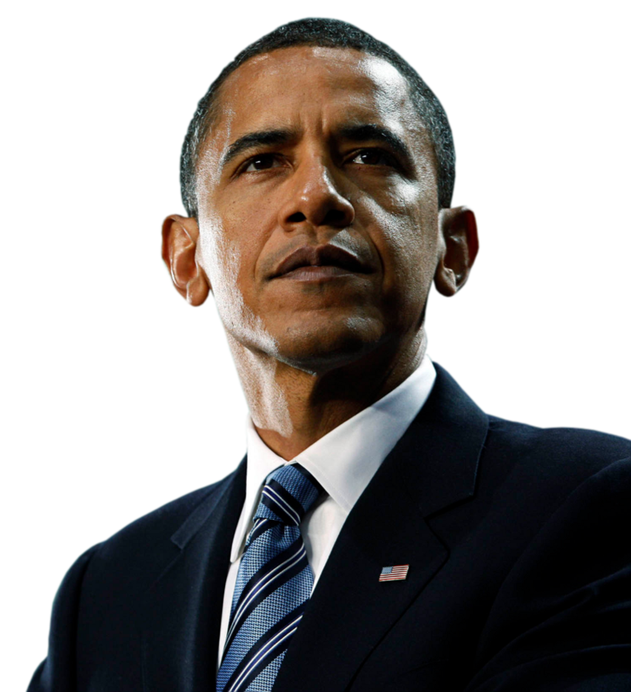
“Cyber threats are one of the most serious economic national security challenges we face as a nation.”
(Cybersecurity and Consumer Protection Summit, 2015)

Slide 4
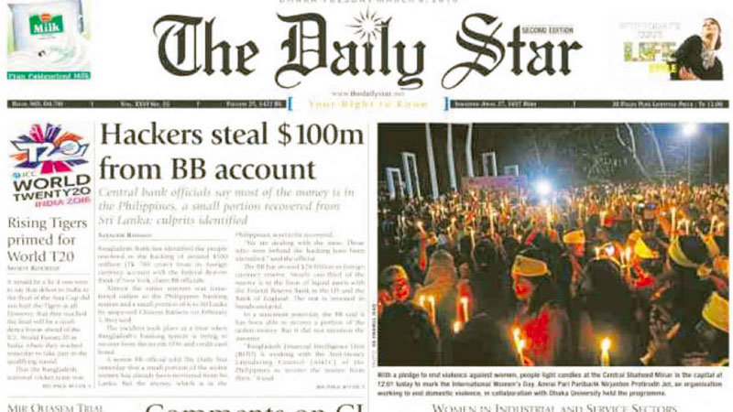
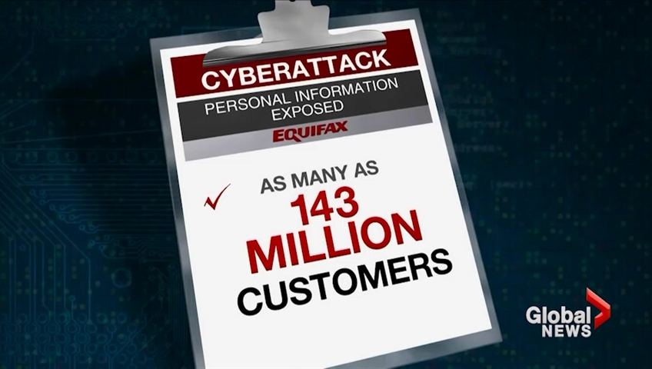
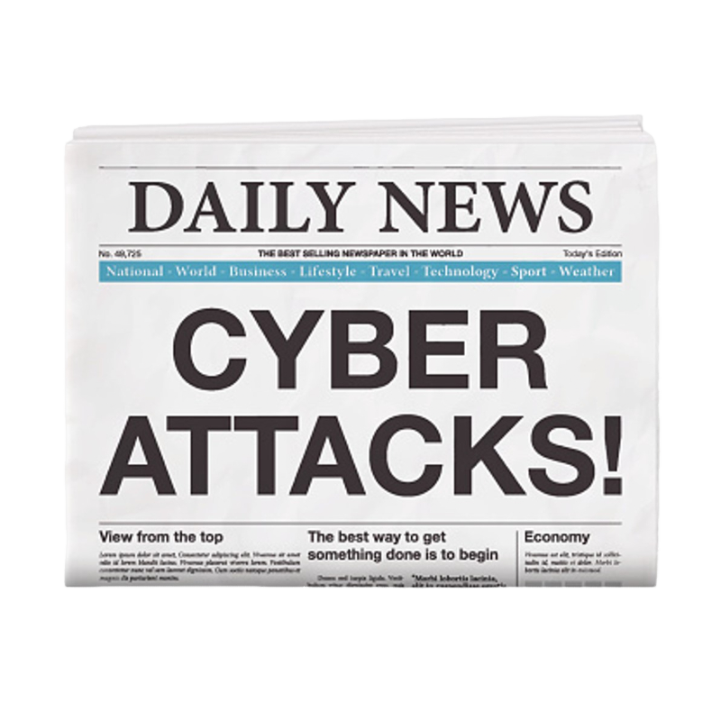
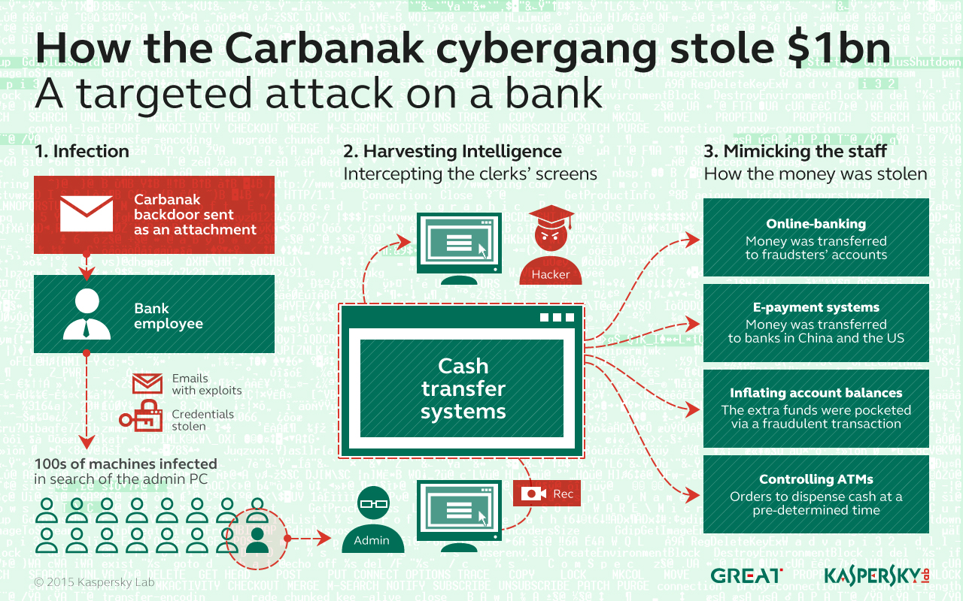
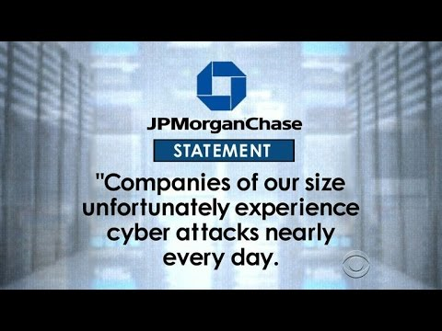

Slide 5
Modes of Attack
Target Core Bank Operations
Transaction Processing, Payment Messaging, and Transaction Authorization Systems
Disruption
Data Breaches and Denial-of-Service
Finance firms lose approximately $5.9 million per data breach, 28% higher than the global average.
— the average cost for breaches of 50 million records or more now tops $300 million.

Slide 6

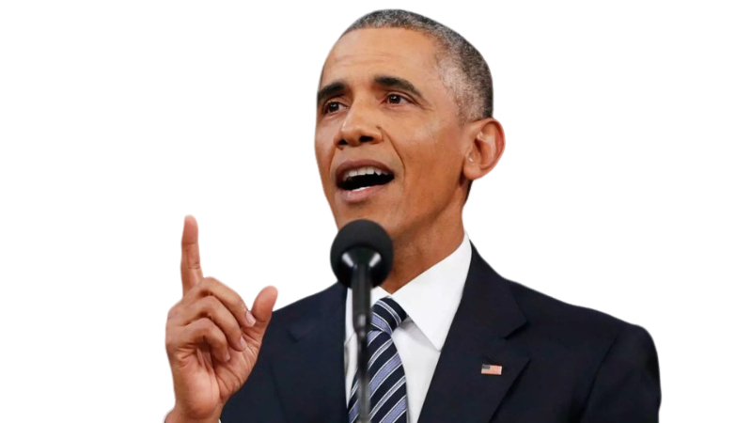
Case Study: PrivatBank
A financial system that provides more than half of Ukraine’s ATM cash withdrawals
Mass Cloud Migration to AWS just days before the 2022 Russian Invasion
A 1.5year migration in just 45 days
Ensuing Kyivstar telecom attack brought down 30% of ATMs
Since the invasion, Ukraine has moved 15 petabytes of critical financial and government data to the cloud
Ukraine: Did you see my Federal Cloud Computing Strategy for Critical Infrastructure?

Slide 7
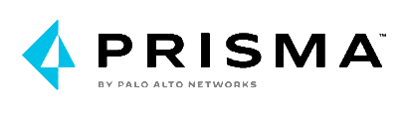
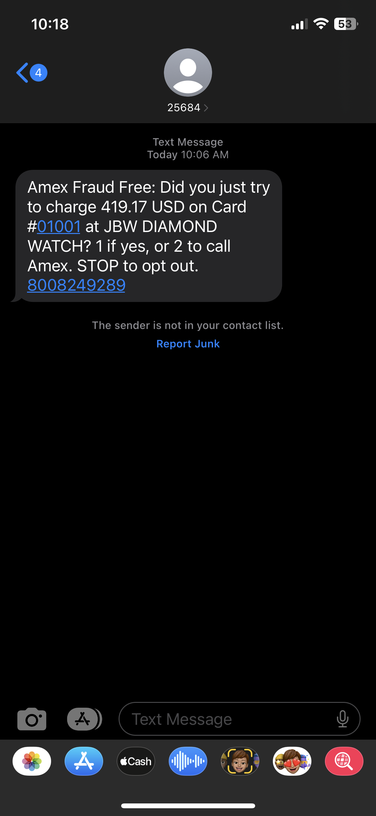
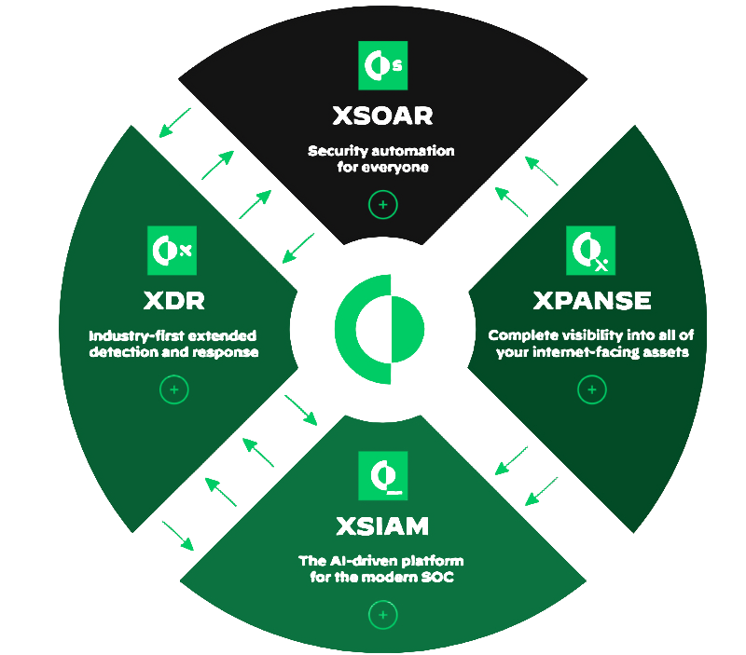
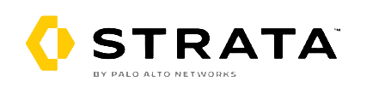
Palo Alto Networks Cloud-Based Suite
Cortex
Prisma
Strata Managed NGFW
ZTNA 2.0
SASE

Slide 8
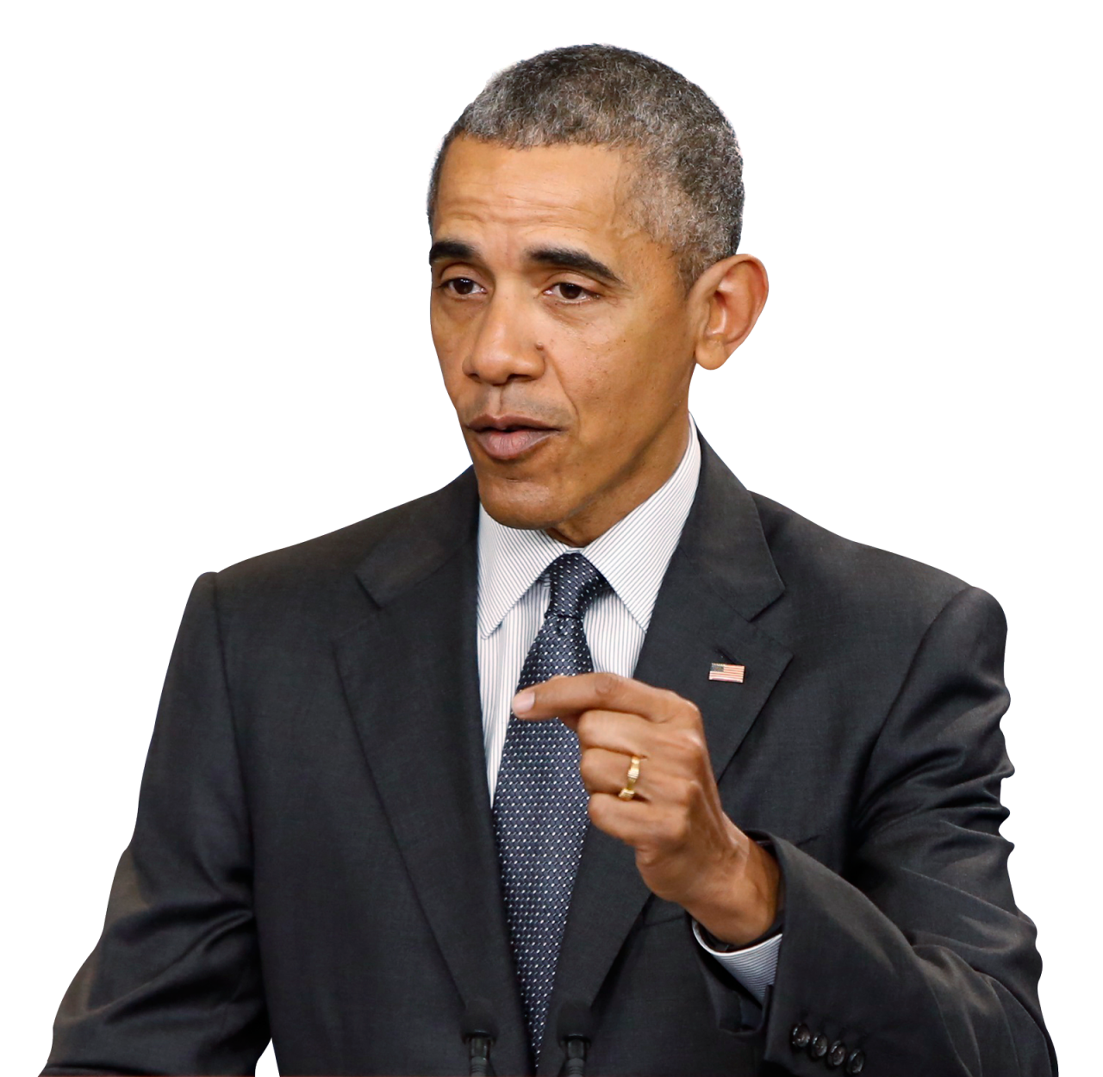
Intelligence Sharing
Financial Industry Regulatory Authority (FINRA)
Society for Worldwide Interbank Financial Telecommunications (SWIFT)
Federal Financial Institutions Examination Council (FFIEC)
Cybersecurity & Infrastructure Security Agency (CISA)
Structured Threat Information Expression (STIX)
Alien Vault (Open Source)
“… through govt and industry working together, sharing appropriate information as true partners.”
“There’s only one way to defend from these cyber threats…”
(Cybersecurity and Consumer Protection Summit, 2015)

Slide 9
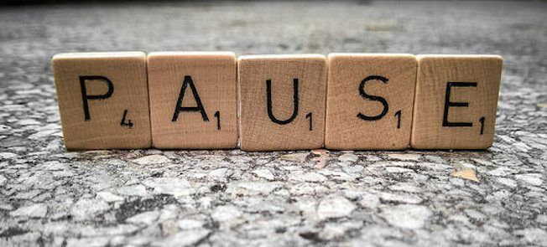
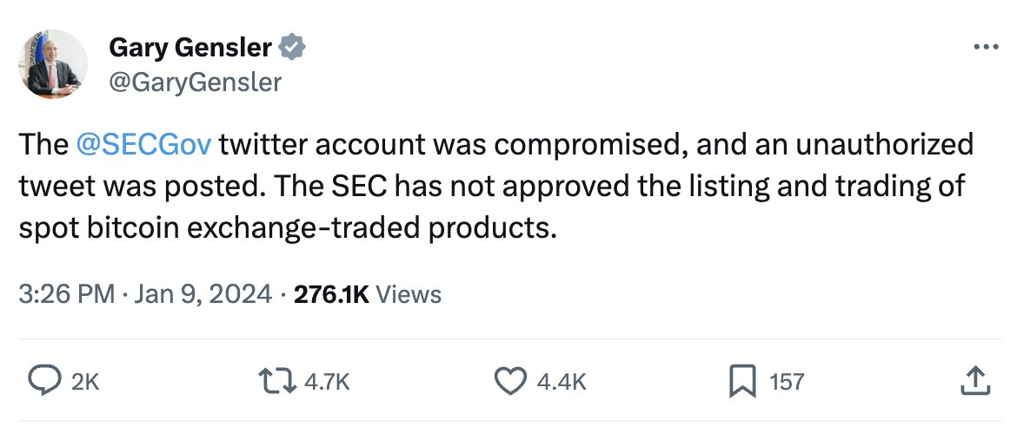
Personnel Security Awareness
Often, the solution to sound cybersecurity needn’t be as sophisticated
Human error accounts for 33% of all financial cyber attacks
Phishing and compromised credentials take the top spots for initial attack vectors at 16% and 15%, respectively
Use PAUSE to identify Phishing emails!

Slide 10
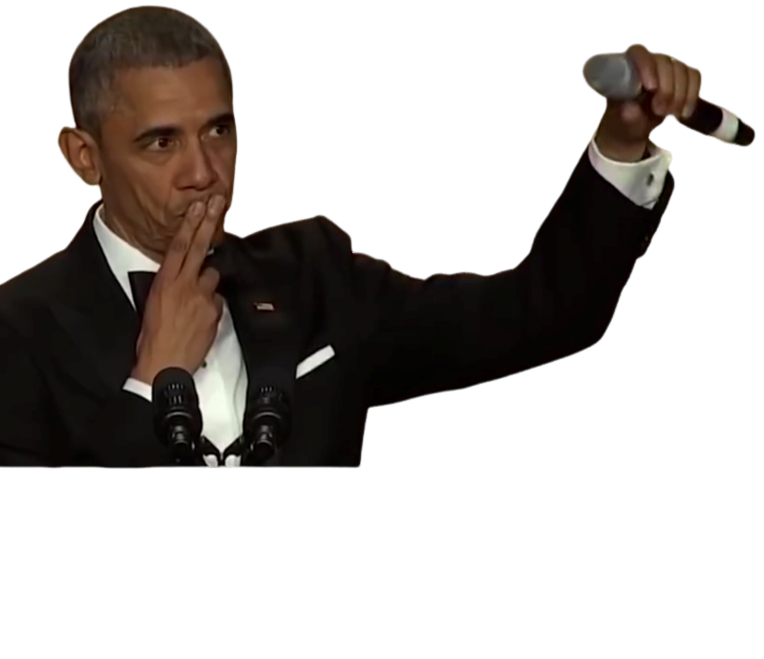
Thank you!
Encourage mass adoption to the Cloud, barring unique exceptions
Adopt the basic principles of Zero Trust and Multi-Factor Authentication
Take advantage of AI and ML in cloud-managed tools like Palo Alto’s
Stay on top of evolving cyber threats with actively managed Intelligence Feeds
Conduct Regular Personnel Cybersecurity Training

Slide 11
Work Cited
Bonderud, Douglas. "Cost of a Data Breach 2023: Financial Industry." Security Intelligence, 30 Aug. 2023, https://securityintelligence.com/articles/cost-of-a-data-breach-2023-financial-industry/. Accessed 22 Dec. 2023.
Nextgov. "How the Push to the Cloud Helped a Ukrainian Bank Keep Faith with Customers Amid War," https://www.nextgov.com/modernization/2023/11/how-push-cloud-helped-ukrainian-bank-keep-faith-customers-amid-war/392375/. Accessed 9 Jan. 2024.
Obama, Barack. “Remarks by the President at the Cybersecurity and Consumer Protection Summit.” The White House Archives, 13 Feb. 2015, https://obamawhitehouse.archives.gov/the-press-office/2015/02/13/remarks-president-cybersecurity-and-consumer-protection-summit. Accessed: 13 Jan. 2024.
Palo Alto Networks. "Cortex XSOAR." Palo Alto Networks, n.d., www.paloaltonetworks.com/ cortex/cortex-xsoar. Accessed 4 Dec. 2023.
Palo Alto Networks. "Prisma Cloud." Palo Alto Networks, n.d., www.paloaltonetworks.com/pri sma/cloud. Accessed 22 Dec. 2023.
Palo Alto Networks. "Secure Access Service Edge (SASE)." Palo Alto Networks, n.d., www.pa loaltonetworks.com/sase. Accessed 23 Dec. 2023.
Palo Alto Networks. "Zero Trust." Palo Alto Networks, n.d., www.paloaltonetworks.com/zero-trust. Accessed 22 Dec. 2023.
PhishLabs. "Cyber Security Awareness Month 2019," https://info.phishlabs.com/cyber-security-awareness-month-2019. Accessed 9 Jan. 2024.
"Russian Nationals Charged with Hacking One Cryptocurrency Exchange and Illicitly Operating Another." Office of Public Affairs, 9 June 2023, https://www.justice.gov/opa/pr/russian-nationals-charged-hacking-one-cryptocurrency-exchange-and-illicitly-operating-another. Accessed 22 Dec. 2023.
Schwartz, Mathew J. "Report: SWIFT Hacked by Bangladesh Bank Attackers." Bank Info Security, 25 April 2016, https://www.bankinfosecurity.com/report-swift-hacked-by-bangladesh-bank-attackers-a-9061. Accessed 22 Dec. 2023.
Statista. "Number of Cyber Incidents in Financial Industry Worldwide." 21 Aug. 2023, https://www.statista.com/statistics/1310985/number-of-cyber-incidents-in-financial-industry-worldwide/#:~:text=Global%20number%20of%20cyber%20attacks%20in%20financial%20sector%202013%2D2022&text=In%202022%2C%20there%20were%201%2C829,2021%20to%20477%20in%202022. Accessed 22 Dec. 2023.
"The White House." Remarks by the President on Securing Our Nation's Cyber Infrastructure, https://obamawhitehouse.archives.gov/the-press-office/remarks-president-securing-our-nations-cyber-infrastructure. Accessed 9 Jan. 2024.
University of the Philippines College of Law. "The Banking and Financial System as a Weapon of War in the Russia-Ukraine Crisis," https://law.upd.edu.ph/faculty-portfolio/the-banking-and-financial-system-as-a-weapon-of-war-in-the-russia-ukraine-crisis/. Accessed 9 Jan. 2024.
Williams, Robert. “Nearly all financial apps have security flaws that leave data vulnerable, study finds.” Marketing Dive. https://www.marketingdive.com/news/nearly-all-financial-apps-have-security-flaws-that-leave-data-vulnerable-s/551794/. Accessed: 22 Dec. 2023.

